Slide 1
Chapter 6
Distributed Database Systems

Slide 2
Outline
Distributed Database Concepts
Data Fragmentation, Replication and Allocation
Types of Distributed Database Systems
Query Processing
Concurrency Control

Slide 3
Distributed Database Concepts
A transaction can be executed by multiple networked computers in a unified manner.
A distributed database (DDB) processes unit of execution (a transaction) in a distributed manner.
A distributed database (DDB) can be defined as :
A distributed database (DDB) is a collection of multiple logically related database distributed over a computer network, and a distributed database management system as a software system that manages a distributed database while making the distribution transparent to the user.
Distributed Database is not a centralized database.

Slide 4
…CON’T
Centralized Database Vs. Distributed Database

Slide 5
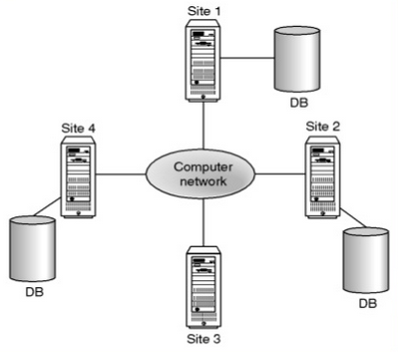
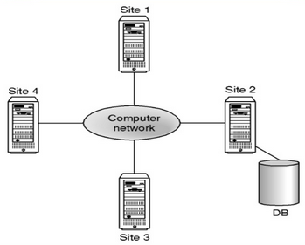
…CON’T
➔ Centralized Database
➔ Distributed Database

Slide 6
Data allocation
is the process of deciding where to allocate/store particular data item.
There are 3 data allocation strategies:
Centralized: the entire DB is located at a single site. And computers access through the network. Known as distributed processing.
Partitioned: the DB is split into several disjoint parts (called partitions, segments or fragments) and stored at several sites
Replicated: copies of one or more partitions are stored at several sites:
3.1 Selective- combines fragmentation (locality of reference for those which are less updated) replication and centralization as appropriate for the data.
3.2 Complete: - database copy is made available in each site. Snap shot is one method used here.

Slide 7
…CON’T
In a distributed database system, the database is logically stored as single database but physically fragmented on several computers.
The computers in a distributed system communicate with each other through various communication media, such as high speed buses or telephone line.
A distributed database system has the following components:
Local DBMS
Distributed DDBMS
Global System Catalog(GSC)
Data communication (DC)

Slide 8
…CON’T
Distributed database system consists of a collection of sites, each of which maintains a local database system (Local DBMS) but each local DBMS also participates in at least one global transaction where different databases are integrated together.
Local Transaction: transactions that access data only in that single site
Global Transaction: transactions that access data in several sites.
Parallel DBMS: a DBMS running across multiple processors and disks that is designed to execute operations in parallel, when ever possible, in order to improve performance.

Slide 9
…CON’T
Three architectures for parallel DBMS:
Shared Memory- for fast data access for a limited number of processors.
Shared Disk- for application inherently centralized
Shared nothing.- massively parallel
What makes DDBMS different is that
The various sites are aware of each other
Each site provides a facility for executing both local and global transactions.
The different sites can be connected physically in different topologies like:
Fully /networked,
Partially Connected,
Tree Network,
Star Network and
Ring Network

Slide 10
…CON’T
The differences between these sites is based on:
Installation Cost: cost of linking sites physically.
Communication Cost: cost to send and receive messages and data
Reliability: resistance to failure
Availability: degree to which data can be accessed despite the failure.

Slide 11
…CON’T
The distribution of the database sites could be:
Large Geographical Area: Long-Haul Network
relatively slow
less reliable
uses telephone line, microwave, satellite
Small Geographical Area: Local Area Network
higher speed
lower rate of error
use twisted pair, base band coaxial, broadband coaxial, fiber optics

Slide 12
…CON’T
Distributed database system consists of loosely joined sites that share no physical component and database systems that run on each site are independent of each other.
Those which share physical components are known as Parallel DBMS.
Transactions may access data at one or more sites
Organization may implement their database system on a number of separate computer system rather than a single, centralized mainframe.
Computer Systems may be located at each local branch office.

Slide 13
Functions of a DDBMS
DDBMS have the following functionality.
Extended Communication Services - to provide access to remote sites.
Extended Data Dictionary- to store data distribution details a need for global system catalog.
Distributed Query Processing - optimization of query remote data access.
Extended security- access control to a distributed data
Extended Concurrency Control –maintain consistency of replicated data.
Extended Recovery Services- failures of individual sites and the communication line.

Slide 14
Issues in DDBMS
How is data stored in DDBMS?
There are several ways of storing a single relation in distributed database systems.
Replication:
System maintains multiple copies of similar data (identical data)
Stored in different sites, for faster retrieval and fault tolerance.
Duplicate copies of the tables can be kept on each system (replicated).
Updates to the tables can become involved (of course the copies of the tables can be read-only).
Advantage: Availability, Increased parallelism (if only reading)-
Disadvantage: increased overhead of update.

Slide 15
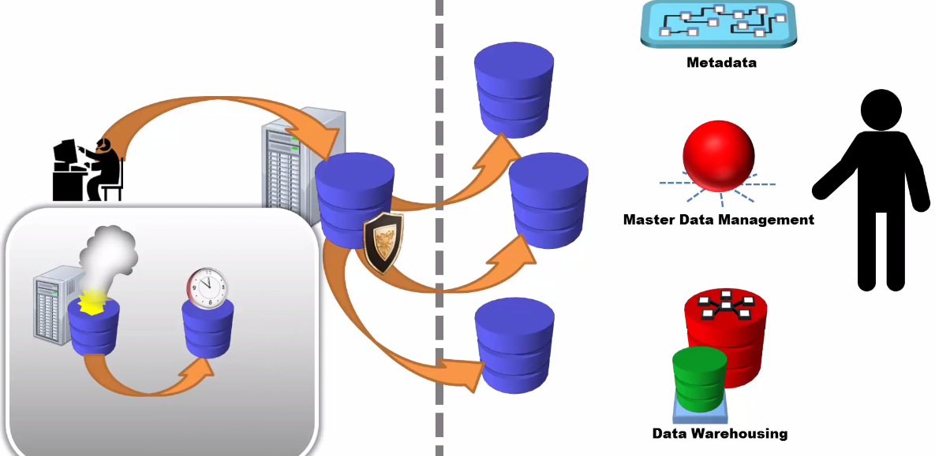
…CON’T
Replication

Slide 16
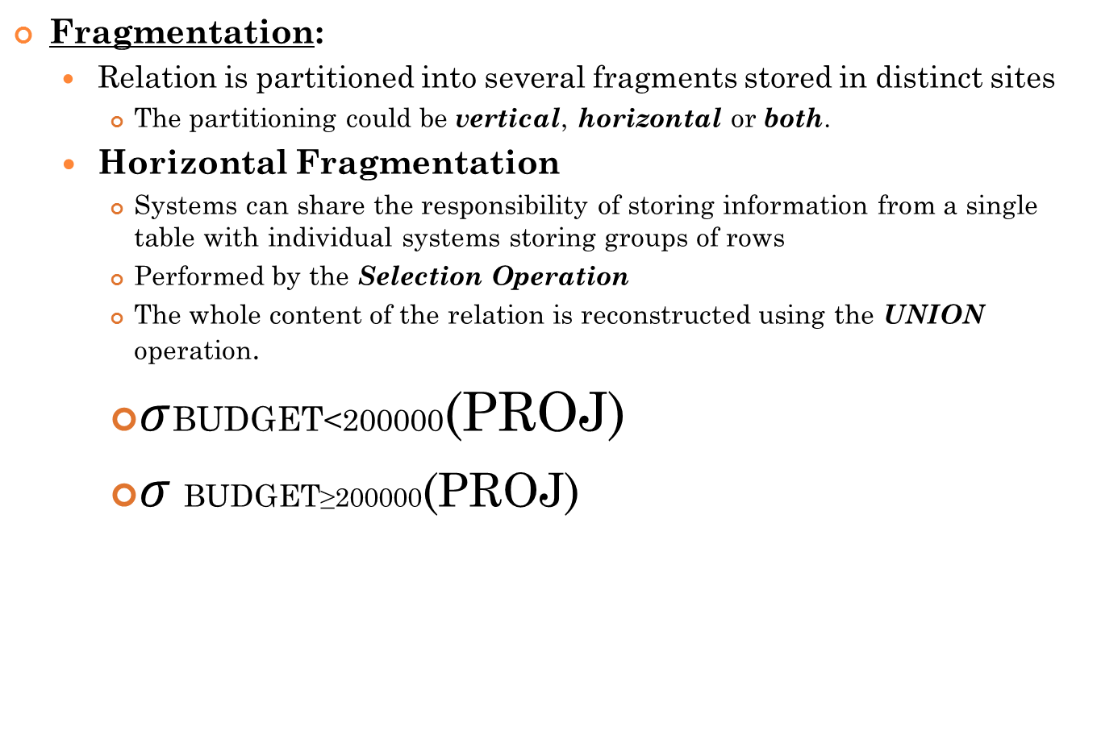

…CON’T

Slide 17
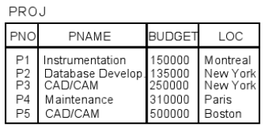
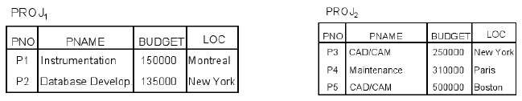
…CON’T
Example (contd.): Horizontal fragmentation of PROJ relation
– PROJ1: projects with budgets less than 200, 000
– PROJ2: projects with budgets greater than or equal to 200, 000

Slide 18
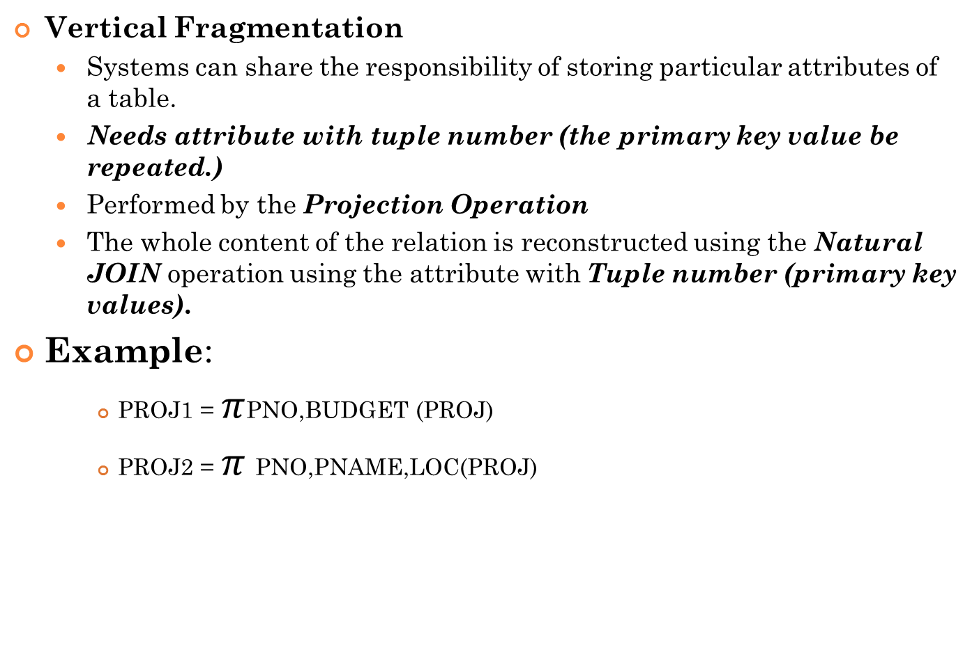

…CON’T

Slide 19
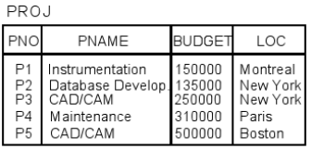
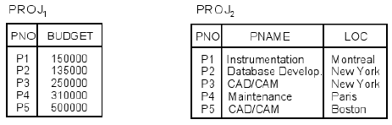
…CON’T
Example: Vertical fragmentation of PROJ relation
PROJ1: information about project budgets
PROJ2: information about project names and locations

Slide 20
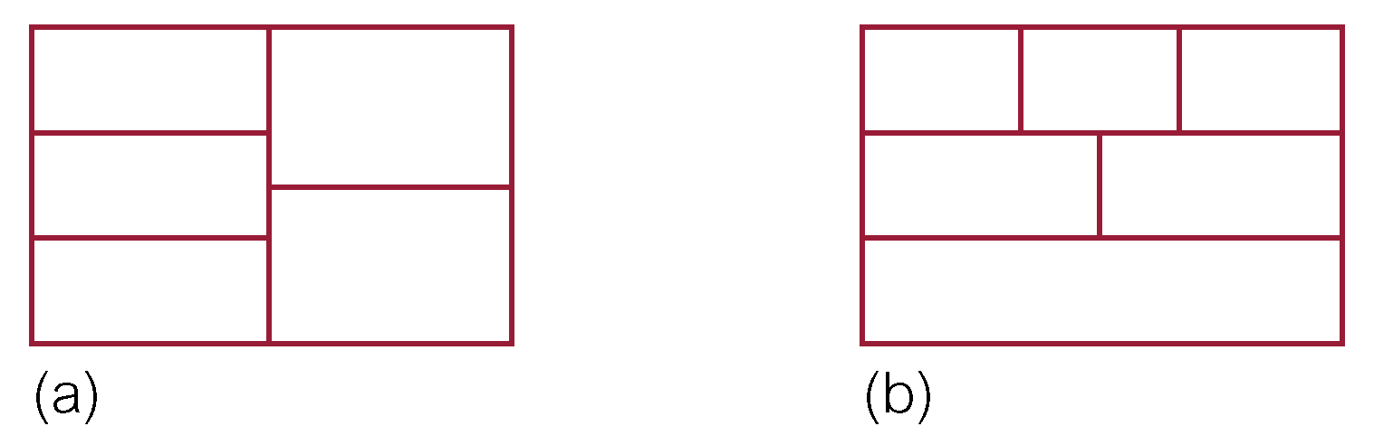
…CON’T
Both (hybrid fragmentation)
A system can share the responsibility of storing particular attributes of a subset of records in a given relation.
Performed by projection then selection or selection then projection relational algebra operators.
Reconstruction is made by combined effect of Union and natural join operators.

Slide 21
…CON’T
Fragmentation is correct if it fulfils the following
Complete: - a data item must appear in at least one fragment of a given relation R (R1, R2…Rn).
Reconstruction:- it must be possible to reconstruct a relation from the fragments
Disjointness: - a data item should only be found in a single fragment except for vertical fragmentation (the primary key is repeated for reconstruction).

Slide 22
Data transparency:
The degree to which system user may remain unaware of the details of how and where the data items are stored in a distributed system.
Distribution transparency Even though there are many systems they appear as one- seen as a single, logical entity.
Replication transparency Copies of data floating around everywhere also seem like just one copy to the developers and users
Fragmentation transparency A table that is actually stored in parts everywhere across sites may seem like just a single table in a single
Location Transparency- the user doesn’t need to know where a data item is physically located.

Slide 23
…CON’T
How does it work?
Distributed computing can be difficult to implement, particularly for replicated data that can be updated from many systems.
In order to operate a distributed database system has to take care of:
Distributed Query Processing
Distributed Transaction Management
Replication Data Management If you are going to have copies of data on many machines how often does the data get updated if it is changed in another system? Who is in charge of propagating the update to the data?
Distributed Database Recovery If one machine goes down how does that affect the others.
Security: Just like any computer network, a distributed system needs to have a common way to validate users entering from any computer in the network of servers.
Common Data-Dictionary Your schema now has to be distinguished and work in connection to schemas created on many systems.

Slide 24
Homogeneous and Heterogeneous Distributed Databases
In a homogeneous distributed database
Are aware of each other and agree to cooperate in processing user requests.
Each site surrenders part of its autonomy in terms of right to change schemas or software
Appears to the user as a single system
All sites of the database system have identical setup, i.e., same database system software.
The underlying operating system may be different.
For example, all sites run Oracle or DB2, or Sybase or some other database system.
The underlying operating systems can be a mixture of Linux, Window, Unix, etc.

Slide 25
…CON’T
In a heterogeneous distributed database
Different sites may use different schemas and software (DBMS)
Difference in schema is a major problem for query processing
Difference in software is a major problem for transaction processing
Sites may not be aware of each other and may provide only limited facilities for cooperation in transaction processing.
May need gateways to interface one another.

Slide 26
Why DDBMS/Advantages
Many existing systems
Possibly there are many different existing system, with possible different kinds of systems (Oracle, Informix, others) that need to be used together.
Data sharing and distributed control:
User at one site may be able access data that is available at another site.
Each site can retain some degree of control over local data
We will have local as well as global database administrator
Reliability and availability of data
If one site fails the rest can continue operation as long as transaction does not demand data from the failed system and the data is not replicated in other sites
Speedup of query processing
If a query involves data from several sites, it may be possible to split the query into sub-queries that can be executed at several sites which is parallel processing
Query can be sent to the least heavily loaded sites
Expansion (Scalability)
In a distributed environment you can easily expand by adding more machines to the network.

Slide 27
Disadvantages of DDBMS
Software Development Cost
Is difficult to install, thus is costly
Greater Potential for Bugs
Parallel processing may endanger correctness of algorithms
Increased Processing Overhead
Exchange of message between sites – high communication latency
Due to communication jargons
Communication problems
Increased Complexity and Data Inconsistency Problems
Since clients can read and modify closely related data stored in different database instances concurrently.
Security Problems: network and replicated data security.

Slide 28
Query Processing and Transaction Management in DDBMS
Query Processing
There are different strategies to process a specific query, which in turn increase the performance of the system by minimizing processing time and cost.
In addition to the cost estimates we have for a centralized database (disk access, relation size, etc), we have to consider the following in distributed query processing:
Cost of data transmission over the huge network
Gain of parallel processing of a single query

Slide 29
…CON’T
Let the distributed database has three sites (S1, S2, and S3). And two relations, EMPLOYEE and DEPARTMENT are located at S1 and S2 respectively without any fragmentation. And a query is initiated from S3 to retrieve employees [First Name (15 byte long), Last name (15 byte long) and Department name (10 byte long) total of 40 bytes with the department they are working in.
Let:
For EMPLOYEE we have the following information
10,000 records
each record is 100 bytes long
For DEPARTMENT we have the following information
100 records
each record is 35 bytes long

Slide 30
…CON’T
There are three ways of executing this query:
Transfer DEPARTMENT and EMPLOYEE to S3 and perform the join there: needs transfer of 10,000*100+100*35=1,003,500 byte.
Transfer the DEPARTMENT to S1, perform the join there which will have 40*10,000 = 400,000 bytes and transfer the result to S3. we need 1,000,000+400,000=1,400,000 byte to be transferred
Transfer the EMPLOYEE to S2, perform the join there which will have 40*10,000 = 400,000 bytes and transfer the result to S3. We need 3,500+400,000=403,500 byte to be transferred.
Then one can select the strategy that will reduce the data transfer cost for this specific query.
Other steps of optimization may also be included to make the processing more efficient by reducing the size of the relations using projection.

Slide 31
Transaction Management
Transaction is a logical unit of work constituted by one or more operations executed by a single user.
A transaction begins with the user's first executable query statement and ends when it is committed or rolled back.
A Distributed Transaction is a transaction that includes one or more statements that, individually or as a group, update data on two or more distinct nodes of a distributed database.
Representation of Query in Distributed Database
SQL Statement | Object | Database | Domain
SELECT * FROM dept@sales.midroc.telecom.et; | dept | sales | midroc.telecom.et;

Slide 32
…CON’T
There are two types of transaction in DDBMS to access data from other sites:
Remote Transaction: contains only statements that access a single remote node.
Remote Query statement is a query that selects information from one or more remote tables, all of which reside at the same remote node or site.
For example, the following query accesses data from the dept table in the Addis schema (the site) of the remote sales database:
SELECT * FROM Addis.dept@sales.midroc.telecom.et;
A remote update statement is an update that modifies data in one or more tables, all of which are collocated at the same remote node.
For example, the following query updates the branch table in the Addis schema of the remote sales database:
UPDATE Addis.dept@ sales.midroc.telecom.et;
SET loc = 'Arada'
WHERE BranchNo = 5;

Slide 33
…CON’T
2. Distributed Transaction: contains statements that access more than one node.
A distributed query statement retrieves information from two or more nodes.
If all statements of a transaction reference only a single remote node, the transaction is remote, not distributed.
A database must guarantee that all statements in a transaction, distributed or non-distributed, either commit or roll back as a unit.
For example, the following query accesses data from the local database as well as the remote sales database:
SELECT ename, dname
FROM Awassa.emp AW, Addis.dept@ sales.midroc.telecom.et AD
WHERE AW.deptno = AD.deptno;
{Employee data is stored in Awassa and Sales data is stored in Addis, there is an employee responsible for each sale }

Slide 34
…CON’T
Remote query
select
client_nm
from
clients@accounts.motorola.com;
Distributed query
select
project_name, student_nm
from
intership@accounts.motorola.com i, student s
where
s.stu_id = i.stu_id
Remote Update
update intership@accounts.motorola.com
set
stu_id = '242'
where stu_id = '200'
Distributed Update
update intership@accounts.motorola.com set
stu_id = '242'
Where stu_id = '200'
update student
Set stu_id = '242‘ where stu_id = '200‘
commit

Slide 35
Concurrency Control
There are various techniques used for concurrency control in centralized database systems.
The techniques in distributed database system are similar with the centralized approach with additional implementation requirements or modifications.
The main difference or the change that should be incorporated is the way the lock manager is implemented and how it functions.
There are different schemes for concurrency control in DDBS

Slide 36
…CON’T
1) Non-Replicated Scheme
No data is replicated in the system
All sites will maintain a local lock manager (local lock and unlock)
If site Si needs a lock on data in site Sj it send message to lock manager of site Sj and the locking will be handled by site Sj
All the locking and unlocking principles are handled by the local lock manager in which the data object resides.
Is simple to implement
Need three message transfers
To request a lock
To notify grant of lock
To request unlock

Slide 37
…CON’T
2) Single Coordinate Approach
The system choose one single lock manager that resides in one of the sites (S_{i})
All locks and unlocks requests are made at site Si where the lock manager resides(S_{i})
Is simple to implement
Needs two message transfers
To request a lock
To request unlock
Simple deadlock handling
Could be a bottleneck since all processes are handled at one site
Is vulnerable/at risk if the site with the lock manager fails

Slide 38
…CON’T
There are three varieties of the 2PL (Two phase locking) protocol in the DDBMS environment.
Implementing the basic 2PL in distributed systems assumes that data is distributed across multiple machines.
Centralized 2PL:
A single site responsible for granting and releasing locks
Each site’s transaction manager communicates with this centralized lock manager and with its own local data manager
Has only one lock manager for the entire site.

Slide 39
…CON’T
Primary 2PL:
Each replicated data item is assigned a primary copy;
the lock manager on that primary copy is responsible for granting and releasing locks(distributed locking) and updates are propagated as soon as possible to the slave copies
Distributes the lock manager to a number of sites
Distributed 2PL:
Assumes data is completely replicated
The schedulers (Lock managers) at each site are responsible in granting and releasing locks as well as forwarding operations to the local data manager.
Distributes the lock manager to every site in the DDBS.
Has communication overhead than the others.

Slide 40
END

